Slide 1







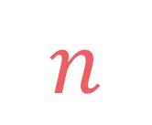

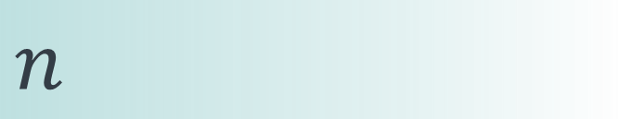

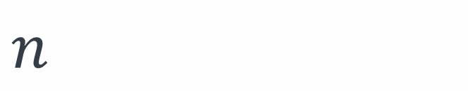
left
[4, 5, 1, 7, 2, 6, 3, 8]
no margin
Space complexity:
$$O(n)$$
list
list
list
list
mid
no margin
"string"
4 | 5 | 1 | 7 | 2 | 6 | 3 | 8
Space complexity:
$$O(n)$$
5
5
$
5
rec(n)
$$n$$
5
$$n$$
$$⇒$$
$$n$$
Time complexity:
$$O(n)$$
text
text
 |  |  | a
$$n$$
text
text
no margin
no margin
no margin
no margin
no margin
no margin
no margin
no margin

Slide 2
Square matrix of ones
0
0
1
1
1
0
1
0
1
1
1
1
0
1
1
1
1
0
1
1
1
1
0
1
0
1
0
1
1
1

Slide 3

Given a matrix made of ones and zeros, find the area of the greatest square submatrix full of ones
$$\left|matrix\right|≥1 \\ \left|matrix\left[0\right]\right|≥1 \\ matrix\left[i\right]\left[j\right]∈\{0,1\}$$

Slide 4
Given a matrix made of ones and zeros, find the area of the greatest square submatrix full of ones
$$\left|matrix\right|≥1 \\ \left|matrix\left[0\right]\right|≥1 \\ matrix\left[i\right]\left[j\right]∈\{0,1\}$$
input:
matrix = [ [0, 0, 1, 1, 1, 0], [1, 0, 1, 1, 1, 1], [0, 1, 1, 1, 1, 0], [1, 1, 1, 1, 0, 1], [0, 1, 0, 1, 1, 1] ]
output: 9
explanation:
0
0
1
1
1
0
1
0
1
1
1
1
0
1
1
1
1
0
1
1
1
1
0
1
0
1
0
1
1
1

Slide 5
def square(matrix): n, m = len(matrix), len(matrix[0]) max_area = 0 for i in range(n): for j in range(m): i_start = i j_start = j while i_start >= 0 and j_start >= 0: if all([matrix[row][col] == 1 for row in range(i_start, i+1) for col in range(j_start, j+1)]): max_area = max(max_area, (i-i_start+1)*(j-j_start+1)) i_start -= 1 j_start -= 1 return max_area

Slide 6

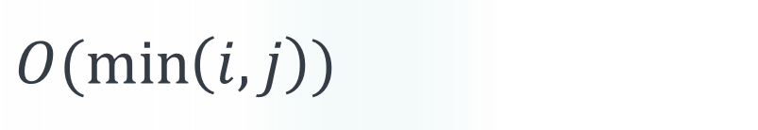
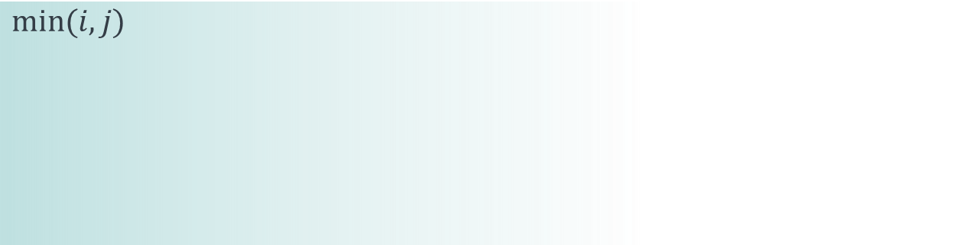

def square(matrix): n, m = len(matrix), len(matrix[0]) max_area = 0 for i in range(n): for j in range(m): i_start = i j_start = j while i_start >= 0 and j_start >= 0: if all([matrix[row][col] == 1 for row in range(i_start, i+1) for col in range(j_start, j+1)]): max_area = max(max_area, (i-i_start+1)*(j-j_start+1)) i_start -= 1 j_start -= 1 return max_area
$$n$$
$$m$$
$$min⁡(i,j)$$
$$O(\min\left(i,j\right))$$
$$T\left(n,m\right)=O(nm\left({\min\left(n,m\right)}^{3}\right))$$

Slide 7

1
1
1
1
1
1
1
1
$$k$$
1
1
1
1
1
1
1
1

Slide 8
1
1
1
1
1
1
1
1
1
1
$$k$$
1
1
1
1
1
1
1
1
1
1

Slide 9
1
1
1
1
1
1
1
1
1
1
$$k$$
1
1
1
1
1
1
1
1
1
1
1
1
1
1

Slide 10

1
1
1
1
1
1
1
1
1
1
$$k$$
1
1
1
1
1
$$k+1$$
1
1
1
1
1
1
1
1
1
1

Slide 11
1
1
1
1
1
1
1
1
1
1
1
1
1
1
1
1
1
1
1
1
1
1
1
1
1
i
j

Slide 12
1
1
1
1
1
1
1
1
1
1
1
1
1
1
1
1
1
1
1
1
1
1
1
1
1
i
j

Slide 13
1
1
1
1
1
1
1
1
1
1
1
1
1
1
1
1
1
1
1
1
i-1
1
1
1
1
1
i
j-1
j

Slide 14
1
1
1
1
1
1
1
1
1
1
1
1
1
1
1
1
1
1
1
1
i-1
1
1
1
1
1
i
j-1
j

Slide 15


1
1
1
1
1
1
1
1
1
1
matrix[i][j] == 0 $→$ we cannot make a square matrix full of ones that ends at matrix[i][j]
1
1
1
1
1
1
1
1
1
1
i-1
1
1
1
1
0
i
j-1
j

Slide 16
1
1
1
1
1
1
1
1
1
1
1
1
1
1
1
1
greatest square matrix full of ones that ends at matrix[i][j]
1
1
1
1
1
1
1
1
1
1
1
1
1
1
1
1
1
1
1
1
1
1
1
1
1
1
1
1
1
1
1
1
1
1
1
1
1
1
1
1
i-1
1
1
1
1
0
1
1
1
i
j-1
j

Slide 17
1
1
1
1
1
1
1
1
1
1
1
1
1
1
1
1
greatest square matrix full of ones that ends at matrix[i][j]
1
1
1
1
1
1
1
1
1
1
1
1
1
1
1
1
1
1
1
1
1
1
1
1
1
1
1
1
1
0
1
1
1
1
1
1
1
1
1
1
i-1
1
1
1
1
1
1
1
1
i
j-1
j

Slide 18

$$matrix\left[i\right]\left[j\right]=1→ \\ rec\left(i,j\right)=1+min⁡(rec\left(i−1,j\right),$$
$rec\left(i,j−1\right),$
$rec\left(i−1,j−1\right))$

Slide 19

$$matrix\left[i\right]\left[j\right]=1→ \\ rec\left(i,j\right)=1+min⁡(rec\left(i−1,j\right),$$
$rec\left(i,j−1\right),$
$rec\left(i−1,j−1\right))$
$$matrix\left[i\right]\left[j\right]=0→rec\left(i,j\right)=0$$

Slide 20
$$matrix\left[i\right]\left[j\right]=1→ \\ rec\left(i,j\right)=1+min⁡(rec\left(i−1,j\right),$$
$rec\left(i,j−1\right),$
$rec\left(i−1,j−1\right))$
$$matrix\left[i\right]\left[j\right]=0→rec\left(i,j\right)=0$$
$$i<0 \text{or} j<0→rec\left(i,j\right)=0$$

Slide 21





$$0$$
$$if i<0 \text{or} j<0 \\ \text{or} matrix\left[i\right]\left[j\right]=0$$
$$rec\left(i,j\right)=$$
$$1+min⁡(rec\left(i−1,j\right),$$
$rec\left(i,j−1\right),$
$rec\left(i−1,j−1\right))$
$$otherwise$$

Slide 22





def rec(matrix, i, j): if i < 0 or j < 0 or matrix[i][j] == 0: return 0 else: return 1 + min(rec(matrix, i-1, j),
rec(matrix, i, j-1),
rec(matrix, i-1, j-1))
$$0$$
$$if i<0 \text{or} j<0 \\ \text{or} matrix\left[i\right]\left[j\right]=0$$
$$rec\left(i,j\right)=$$
$$1+min⁡(rec\left(i−1,j\right),$$
$rec\left(i,j−1\right),$
$rec\left(i−1,j−1\right))$
$$otherwise$$

Slide 23
def rec(matrix, i, j): if i < 0 or j < 0 or matrix[i][j] == 0: return 0 else: return 1 + min(rec(matrix, i-1, j),
rec(matrix, i, j-1),
rec(matrix, i-1, j-1))
def square(matrix): n, m = len(matrix), len(matrix[0]) max_size = 0 for i in range(n): for j in range(m): max_size = max(max_size, rec(matrix, i, j)) return max_size**2

Slide 24

def rec(matrix, i, j): if i < 0 or j < 0 or matrix[i][j] == 0: return 0 else: return 1 + min(rec(matrix, i-1, j),
rec(matrix, i, j-1),
rec(matrix, i-1, j-1))
number of subproblems: $3$
height of the recursion tree: $i+j+1$

Slide 25

def rec(matrix, i, j): if i < 0 or j < 0 or matrix[i][j] == 0: return 0 else: return 1 + min(rec(matrix, i-1, j),
rec(matrix, i, j-1),
rec(matrix, i-1, j-1))
number of subproblems: $3$
height of the recursion tree: $i+j+1$

Slide 26

def rec(matrix, i, j): if i < 0 or j < 0 or matrix[i][j] == 0: return 0 else: return 1 + min(rec(matrix, i-1, j),
rec(matrix, i, j-1),
rec(matrix, i-1, j-1))
number of subproblems: $3$
height of the recursion tree: $i+j+1$
$$T\left(i,j\right)=O(3^{i+j})$$

Slide 27
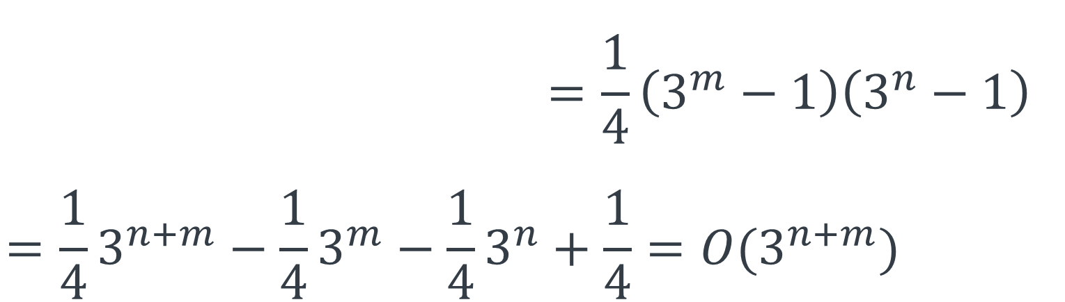
def square(matrix): n, m = len(matrix), len(matrix[0]) max_size = 0 for i in range(n): for j in range(m): max_size = max(max_size, rec(matrix, i, j)) return max_size**2
$$T_{2}\left(n,m\right)=\sum_{i=0}^{n−1}{\sum_{j=0}^{m−1}{3^{i+j}}=\frac{1}{4}\left(3^{m}−1\right)\left(3^{n}−1\right)} \\ =\frac{1}{4}3^{n+m}−\frac{1}{4}3^{m}−\frac{1}{4}3^{n}+\frac{1}{4}=O(3^{n+m})$$

Slide 28
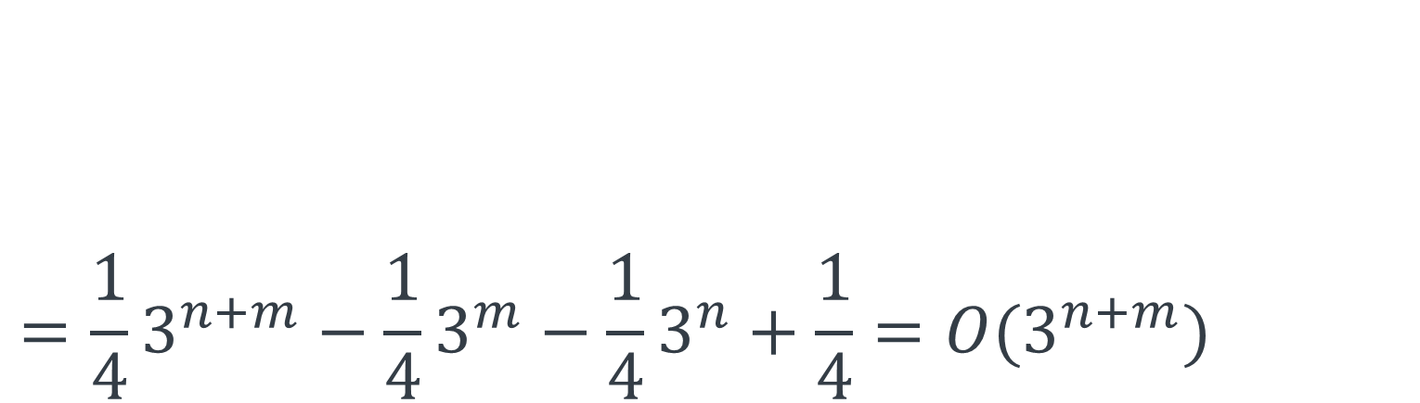
def square(matrix): n, m = len(matrix), len(matrix[0]) max_size = 0 for i in range(n): for j in range(m): max_size = max(max_size, rec(matrix, i, j)) return max_size**2
$$T_{2}\left(n,m\right)=\sum_{i=0}^{n−1}{\sum_{j=0}^{m−1}{3^{i+j}}=\frac{1}{4}\left(3^{m}−1\right)\left(3^{n}−1\right)} \\ =\frac{1}{4}3^{n+m}−\frac{1}{4}3^{m}−\frac{1}{4}3^{n}+\frac{1}{4}=O(3^{n+m})$$

Slide 29
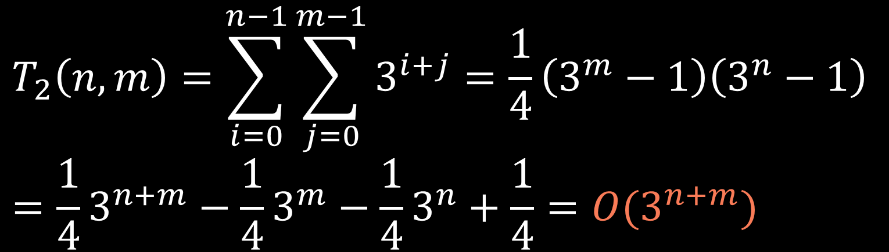
def square(matrix): n, m = len(matrix), len(matrix[0]) max_size = 0 for i in range(n): for j in range(m): max_size = max(max_size, rec(matrix, i, j)) return max_size**2
$$T_{2}\left(n,m\right)=\sum_{i=0}^{n−1}{\sum_{j=0}^{m−1}{3^{i+j}}=\frac{1}{4}\left(3^{m}−1\right)\left(3^{n}−1\right)} \\ =\frac{1}{4}3^{n+m}−\frac{1}{4}3^{m}−\frac{1}{4}3^{n}+\frac{1}{4}=O(3^{n+m})$$

Slide 30

rec(-1,0)
$$S\left(n,m\right)=n+m=O\left(n+m\right)$$
.
.
.
$$n+m$$
rec(n-2,m-2)
rec(n-2,m-1)
rec(n-1,m-1)

Slide 31
input:
matrix = [ [0, 0, 1, 1], [1, 0, 1, 1], [0, 1, 1, 1], [1, 1, 1, 1], ]
i = 3
j = 3
rec
(-1,-1)
rec
(-1,0)
rec
(-1,1)
rec
(-1,2)
rec
(-1,3)
rec
(0,-1)
rec
(0,0)
rec
(0,1)
rec
(0,2)
rec
(0,3)
rec
(1,-1)
rec
(1,0)
rec
(1,1)
rec
(1,2)
rec
(1,3)
rec
(2,-1)
rec
(2,0)
rec
(2,1)
rec
(2,2)
rec
(2,3)
rec
(3,-1)
rec
(3,0)
rec
(3,1)
rec
(3,2)
rec
(3,3)

Slide 32
input:
matrix = [ [0, 0, 1, 1], [1, 0, 1, 1], [0, 1, 1, 1], [1, 1, 1, 1], ]
i = 3
j = 3
rec
(-1,-1)
rec
(-1,0)
rec
(-1,1)
rec
(-1,2)
rec
(-1,3)
rec
(0,-1)
rec
(0,0)
rec
(0,1)
rec
(0,2)
rec
(0,3)
rec
(1,-1)
rec
(1,0)
rec
(1,1)
rec
(1,2)
rec
(1,3)
rec
(2,-1)
rec
(2,0)
rec
(2,1)
rec
(2,2)
rec
(2,3)
rec
(3,-1)
rec
(3,0)
rec
(3,1)
rec
(3,2)
rec
(3,3)

Slide 33
1
def rec(matrix, i, j, lookup): if (i, j) in lookup: return lookup[(i, j)] if i < 0 or j < 0 or matrix[i][j] == 0: return 0 else: lookup[(i, j)] = 1 + min(rec(matrix, i-1, j, lookup),
rec(matrix, i, j-1, lookup),
rec(matrix, i-1, j-1, lookup)) return lookup[(i, j)] def square(matrix): n, m = len(matrix), len(matrix[0]) max_size = 0 lookup = {} for i in range(n): for j in range(m): max_size = max(max_size, rec(matrix, i, j, lookup)) return max_size**2
3
4
2

Slide 34




$$i∈\{0,1,…,n−1\}$$
$$j∈\{0,1,…,m−1\}$$
$$n$$
$$m$$

Slide 35
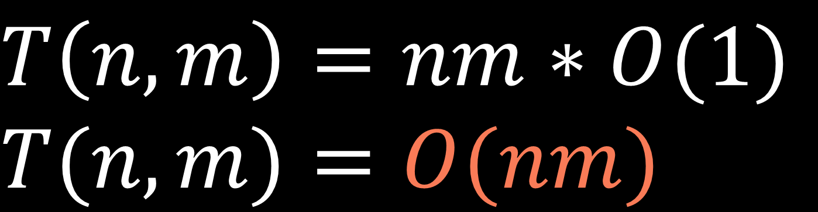
$$i∈\{0,1,…,n−1\}$$
$$j∈\{0,1,…,m−1\}$$
$$n$$
$$m$$
$$T\left(n,m\right)=nm∗O(1)$$
$$T(n,m)=O(nm)$$

Slide 36
$$S(n,m)=O\left(n+m\right)+O\left(nm\right)=O(nm)$$
call stack size
lookup table size

Slide 37






$$i∈\{0,1,…,n−1\}$$
$$j∈\{0,1,…,m−1\}$$
$$n$$
$$m$$
$$m$$
$$n$$

Slide 38
dp[i][j] represents the size of the greatest square matrix full of ones that ends at the cell i j

Slide 39


1
0
1
1
$matrix\left[0\right]\left[0\right]=1 →$ size of the greatest square matrix full of ones that ends in $matrix[0][0]$ is $1$
1
0
1
1
0
1
1
1
0
0
1
1
$matrix\left[0\right]\left[0\right]=0 →$ size of the greatest square matrix full of ones that ends in $matrix[0][0]$ is $0$
1
0
1
1
0
1
1
1

Slide 40
def square(matrix): n, m = len(matrix), len(matrix[0]) dp = [[0] * m for i in range(n)] dp[0][0] = matrix[0][0] for j in range(1, m): dp[0][j] = matrix[0][j] for i in range(1, n): dp[i][0] = matrix[i][0] for i in range(1, n): for j in range(1, m): dp[i][j] = 0 if matrix[i][j] == 0 else 1 + min(dp[i-1][j],
dp[i][j-1],
dp[i-1][j-1]) return max(map(max,dp))**2

Slide 41




1
0
1
1
$matrix\left[0\right]\left[j\right]=1 →$ size of the greatest square matrix full of ones that ends in $matrix[0][j]$ is $1$
1
0
1
1
$matrix\left[i\right]\left[0\right]=1 →$ size of the greatest square matrix full of ones that ends in $matrix[i][0]$ is $1$
0
1
1
1
1
0
0
1
$matrix\left[0\right]\left[j\right]=0 →$ size of the greatest square matrix full of ones that ends in $matrix[0][j]$ is $0$
0
0
1
1
$matrix\left[i\right]\left[0\right]=0 →$ size of the greatest square matrix full of ones that ends in $matrix[i][0]$ is $0$
0
1
1
1

Slide 42
def square(matrix): n, m = len(matrix), len(matrix[0]) dp = [[0] * m for i in range(n)] dp[0][0] = matrix[0][0] for j in range(1, m): dp[0][j] = matrix[0][j] for i in range(1, n): dp[i][0] = matrix[i][0] for i in range(1, n): for j in range(1, m): dp[i][j] = 0 if matrix[i][j] == 0 else 1 + min(dp[i-1][j],
dp[i][j-1],
dp[i-1][j-1]) return max(map(max,dp))**2

Slide 43
def square(matrix): n, m = len(matrix), len(matrix[0]) dp = [[0] * m for i in range(n)] dp[0][0] = matrix[0][0] for j in range(1, m): dp[0][j] = matrix[0][j] for i in range(1, n): dp[i][0] = matrix[i][0] for i in range(1, n): for j in range(1, m): dp[i][j] = 0 if matrix[i][j] == 0 else 1 + min(dp[i-1][j],
dp[i][j-1],
dp[i-1][j-1]) return max(map(max,dp))**2

Slide 44
def square(matrix): n, m = len(matrix), len(matrix[0]) dp = [[0] * m for i in range(n)] dp[0][0] = matrix[0][0] for j in range(1, m): dp[0][j] = matrix[0][j] for i in range(1, n): dp[i][0] = matrix[i][0] for i in range(1, n): for j in range(1, m): dp[i][j] = 0 if matrix[i][j] == 0 else 1 + min(dp[i-1][j],
dp[i][j-1],
dp[i-1][j-1]) return max(map(max,dp))**2

Slide 45
matrix
0
0
1
1
1
0
dp
1
0
1
1
1
1
0
1
1
1
1
0
1
1
1
1
0
1
0
1
0
1
1
1
def square(matrix): n, m = len(matrix), len(matrix[0]) dp = [[0] * m for i in range(n)] dp[0][0] = matrix[0][0] for j in range(1, m): dp[0][j] = matrix[0][j] for i in range(1, n): dp[i][0] = matrix[i][0] for i in range(1, n): for j in range(1, m): dp[i][j] = 0 if matrix[i][j] == 0 else 1 + min(dp[i-1][j],
dp[i][j-1],
dp[i-1][j-1]) return max(map(max,dp))**2

Slide 46
matrix
0
0
1
1
1
0
dp
1
0
1
1
1
1
0
0
1
1
1
0
0
1
1
1
1
0
1
1
1
1
1
0
1
0
1
0
1
1
1
0
def square(matrix): n, m = len(matrix), len(matrix[0]) dp = [[0] * m for i in range(n)] dp[0][0] = matrix[0][0] for j in range(1, m): dp[0][j] = matrix[0][j] for i in range(1, n): dp[i][0] = matrix[i][0] for i in range(1, n): for j in range(1, m): dp[i][j] = 0 if matrix[i][j] == 0 else 1 + min(dp[i-1][j],
dp[i][j-1],
dp[i-1][j-1]) return max(map(max,dp))**2
1
0

Slide 47
matrix
0
0
1
1
1
0
dp
1
0
1
1
1
1
0
0
1
1
1
0
0
1
1
1
1
0
1
1
1
1
1
0
1
0
1
0
1
1
1
0
def square(matrix): n, m = len(matrix), len(matrix[0]) dp = [[0] * m for i in range(n)] dp[0][0] = matrix[0][0] for j in range(1, m): dp[0][j] = matrix[0][j] for i in range(1, n): dp[i][0] = matrix[i][0] for i in range(1, n): for j in range(1, m): dp[i][j] = 0 if matrix[i][j] == 0 else 1 + min(dp[i-1][j],
dp[i][j-1],
dp[i-1][j-1]) return max(map(max,dp))**2
1
0

Slide 48
matrix
0
0
1
1
1
0
dp
1
0
1
1
1
1
0
0
1
1
1
0
0
1
1
1
1
0
1
0
1
1
1
1
0
1
0
1
0
1
1
1
0
def square(matrix): n, m = len(matrix), len(matrix[0]) dp = [[0] * m for i in range(n)] dp[0][0] = matrix[0][0] for j in range(1, m): dp[0][j] = matrix[0][j] for i in range(1, n): dp[i][0] = matrix[i][0] for i in range(1, n): for j in range(1, m): dp[i][j] = 0 if matrix[i][j] == 0 else 1 + min(dp[i-1][j],
dp[i][j-1],
dp[i-1][j-1]) return max(map(max,dp))**2
1
0

Slide 49
matrix
0
0
1
1
1
0
dp
1
0
1
1
1
1
0
0
1
1
1
0
0
1
1
1
1
0
1
0
1
1
1
1
0
1
0
1
0
1
1
1
0
def square(matrix): n, m = len(matrix), len(matrix[0]) dp = [[0] * m for i in range(n)] dp[0][0] = matrix[0][0] for j in range(1, m): dp[0][j] = matrix[0][j] for i in range(1, n): dp[i][0] = matrix[i][0] for i in range(1, n): for j in range(1, m): dp[i][j] = 0 if matrix[i][j] == 0 else 1 + min(dp[i-1][j],
dp[i][j-1],
dp[i-1][j-1]) return max(map(max,dp))**2
1
0

Slide 50
matrix
0
0
1
1
1
0
dp
1
0
1
1
1
1
0
0
1
1
1
0
0
1
1
1
1
0
1
0
1
1
1
1
1
0
1
0
1
0
1
1
1
0
def square(matrix): n, m = len(matrix), len(matrix[0]) dp = [[0] * m for i in range(n)] dp[0][0] = matrix[0][0] for j in range(1, m): dp[0][j] = matrix[0][j] for i in range(1, n): dp[i][0] = matrix[i][0] for i in range(1, n): for j in range(1, m): dp[i][j] = 0 if matrix[i][j] == 0 else 1 + min(dp[i-1][j],
dp[i][j-1],
dp[i-1][j-1]) return max(map(max,dp))**2
1
0

Slide 51
matrix
0
0
1
1
1
0
dp
1
0
1
1
1
1
0
0
1
1
1
0
0
1
1
1
1
0
1
0
1
1
1
1
1
0
1
0
1
0
1
1
1
0
def square(matrix): n, m = len(matrix), len(matrix[0]) dp = [[0] * m for i in range(n)] dp[0][0] = matrix[0][0] for j in range(1, m): dp[0][j] = matrix[0][j] for i in range(1, n): dp[i][0] = matrix[i][0] for i in range(1, n): for j in range(1, m): dp[i][j] = 0 if matrix[i][j] == 0 else 1 + min(dp[i-1][j],
dp[i][j-1],
dp[i-1][j-1]) return max(map(max,dp))**2
1
0

Slide 52
matrix
0
0
1
1
1
0
dp
1
0
1
1
1
1
0
0
1
1
1
0
0
1
1
1
1
0
1
0
1
2
1
1
1
1
0
1
0
1
0
1
1
1
0
def square(matrix): n, m = len(matrix), len(matrix[0]) dp = [[0] * m for i in range(n)] dp[0][0] = matrix[0][0] for j in range(1, m): dp[0][j] = matrix[0][j] for i in range(1, n): dp[i][0] = matrix[i][0] for i in range(1, n): for j in range(1, m): dp[i][j] = 0 if matrix[i][j] == 0 else 1 + min(dp[i-1][j],
dp[i][j-1],
dp[i-1][j-1]) return max(map(max,dp))**2
1
0

Slide 53
matrix
0
0
1
1
1
0
dp
1
0
1
1
1
1
0
0
1
1
1
0
0
1
1
1
1
0
1
0
1
2
1
1
1
1
0
1
0
1
0
1
1
1
0
def square(matrix): n, m = len(matrix), len(matrix[0]) dp = [[0] * m for i in range(n)] dp[0][0] = matrix[0][0] for j in range(1, m): dp[0][j] = matrix[0][j] for i in range(1, n): dp[i][0] = matrix[i][0] for i in range(1, n): for j in range(1, m): dp[i][j] = 0 if matrix[i][j] == 0 else 1 + min(dp[i-1][j],
dp[i][j-1],
dp[i-1][j-1]) return max(map(max,dp))**2
1
0

Slide 54
matrix
0
0
1
1
1
0
dp
1
0
1
1
1
1
0
0
1
1
1
0
0
1
1
1
1
0
1
0
1
2
2
1
1
1
1
0
1
0
1
0
1
1
1
0
def square(matrix): n, m = len(matrix), len(matrix[0]) dp = [[0] * m for i in range(n)] dp[0][0] = matrix[0][0] for j in range(1, m): dp[0][j] = matrix[0][j] for i in range(1, n): dp[i][0] = matrix[i][0] for i in range(1, n): for j in range(1, m): dp[i][j] = 0 if matrix[i][j] == 0 else 1 + min(dp[i-1][j],
dp[i][j-1],
dp[i-1][j-1]) return max(map(max,dp))**2
1
0

Slide 55
matrix
0
0
1
1
1
0
dp
1
0
1
1
1
1
0
0
1
1
1
0
0
1
1
1
1
0
1
0
1
2
2
1
1
1
1
0
1
0
1
0
1
1
1
0
def square(matrix): n, m = len(matrix), len(matrix[0]) dp = [[0] * m for i in range(n)] dp[0][0] = matrix[0][0] for j in range(1, m): dp[0][j] = matrix[0][j] for i in range(1, n): dp[i][0] = matrix[i][0] for i in range(1, n): for j in range(1, m): dp[i][j] = 0 if matrix[i][j] == 0 else 1 + min(dp[i-1][j],
dp[i][j-1],
dp[i-1][j-1]) return max(map(max,dp))**2
1
0

Slide 56
matrix
0
0
1
1
1
0
dp
1
0
1
1
1
1
0
0
1
1
1
0
0
1
1
1
1
0
1
0
1
2
2
1
1
1
1
1
0
1
0
1
0
1
1
1
0
def square(matrix): n, m = len(matrix), len(matrix[0]) dp = [[0] * m for i in range(n)] dp[0][0] = matrix[0][0] for j in range(1, m): dp[0][j] = matrix[0][j] for i in range(1, n): dp[i][0] = matrix[i][0] for i in range(1, n): for j in range(1, m): dp[i][j] = 0 if matrix[i][j] == 0 else 1 + min(dp[i-1][j],
dp[i][j-1],
dp[i-1][j-1]) return max(map(max,dp))**2
1
0

Slide 57
matrix
0
0
1
1
1
0
dp
1
0
1
1
1
1
0
0
1
1
1
0
0
1
1
1
1
0
1
0
1
2
2
1
1
1
1
1
0
1
0
1
0
1
1
1
0
1
def square(matrix): n, m = len(matrix), len(matrix[0]) dp = [[0] * m for i in range(n)] dp[0][0] = matrix[0][0] for j in range(1, m): dp[0][j] = matrix[0][j] for i in range(1, n): dp[i][0] = matrix[i][0] for i in range(1, n): for j in range(1, m): dp[i][j] = 0 if matrix[i][j] == 0 else 1 + min(dp[i-1][j],
dp[i][j-1],
dp[i-1][j-1]) return max(map(max,dp))**2
1
0

Slide 58
matrix
0
0
1
1
1
0
dp
1
0
1
1
1
1
0
0
1
1
1
0
0
1
1
1
1
0
1
0
1
2
2
1
1
1
1
1
0
1
0
1
0
1
1
1
0
1
1
def square(matrix): n, m = len(matrix), len(matrix[0]) dp = [[0] * m for i in range(n)] dp[0][0] = matrix[0][0] for j in range(1, m): dp[0][j] = matrix[0][j] for i in range(1, n): dp[i][0] = matrix[i][0] for i in range(1, n): for j in range(1, m): dp[i][j] = 0 if matrix[i][j] == 0 else 1 + min(dp[i-1][j],
dp[i][j-1],
dp[i-1][j-1]) return max(map(max,dp))**2
1
0

Slide 59
matrix
0
0
1
1
1
0
dp
1
0
1
1
1
1
0
0
1
1
1
0
0
1
1
1
1
0
1
0
1
2
2
1
1
1
1
1
0
1
0
1
0
1
1
1
0
1
1
2
def square(matrix): n, m = len(matrix), len(matrix[0]) dp = [[0] * m for i in range(n)] dp[0][0] = matrix[0][0] for j in range(1, m): dp[0][j] = matrix[0][j] for i in range(1, n): dp[i][0] = matrix[i][0] for i in range(1, n): for j in range(1, m): dp[i][j] = 0 if matrix[i][j] == 0 else 1 + min(dp[i-1][j],
dp[i][j-1],
dp[i-1][j-1]) return max(map(max,dp))**2
1
0

Slide 60
matrix
0
0
1
1
1
0
dp
1
0
1
1
1
1
0
0
1
1
1
0
0
1
1
1
1
0
1
0
1
2
2
1
1
1
1
1
0
1
0
1
0
1
1
1
0
1
1
2
3
def square(matrix): n, m = len(matrix), len(matrix[0]) dp = [[0] * m for i in range(n)] dp[0][0] = matrix[0][0] for j in range(1, m): dp[0][j] = matrix[0][j] for i in range(1, n): dp[i][0] = matrix[i][0] for i in range(1, n): for j in range(1, m): dp[i][j] = 0 if matrix[i][j] == 0 else 1 + min(dp[i-1][j],
dp[i][j-1],
dp[i-1][j-1]) return max(map(max,dp))**2
1
0

Slide 61
matrix
0
0
1
1
1
0
dp
1
0
1
1
1
1
0
0
1
1
1
0
0
1
1
1
1
0
1
0
1
2
2
1
1
1
1
1
0
1
0
1
0
1
1
1
0
1
1
2
3
0
def square(matrix): n, m = len(matrix), len(matrix[0]) dp = [[0] * m for i in range(n)] dp[0][0] = matrix[0][0] for j in range(1, m): dp[0][j] = matrix[0][j] for i in range(1, n): dp[i][0] = matrix[i][0] for i in range(1, n): for j in range(1, m): dp[i][j] = 0 if matrix[i][j] == 0 else 1 + min(dp[i-1][j],
dp[i][j-1],
dp[i-1][j-1]) return max(map(max,dp))**2
1
0

Slide 62
matrix
0
0
1
1
1
0
dp
1
0
1
1
1
1
0
0
1
1
1
0
0
1
1
1
1
0
1
0
1
2
2
1
1
1
1
1
0
1
0
1
0
1
1
1
0
1
1
2
3
0
def square(matrix): n, m = len(matrix), len(matrix[0]) dp = [[0] * m for i in range(n)] dp[0][0] = matrix[0][0] for j in range(1, m): dp[0][j] = matrix[0][j] for i in range(1, n): dp[i][0] = matrix[i][0] for i in range(1, n): for j in range(1, m): dp[i][j] = 0 if matrix[i][j] == 0 else 1 + min(dp[i-1][j],
dp[i][j-1],
dp[i-1][j-1]) return max(map(max,dp))**2
1
1
0

Slide 63
matrix
0
0
1
1
1
0
dp
1
0
1
1
1
1
0
0
1
1
1
0
0
1
1
1
1
0
1
0
1
2
2
1
1
1
1
1
0
1
0
1
0
1
1
1
0
1
1
2
3
0
def square(matrix): n, m = len(matrix), len(matrix[0]) dp = [[0] * m for i in range(n)] dp[0][0] = matrix[0][0] for j in range(1, m): dp[0][j] = matrix[0][j] for i in range(1, n): dp[i][0] = matrix[i][0] for i in range(1, n): for j in range(1, m): dp[i][j] = 0 if matrix[i][j] == 0 else 1 + min(dp[i-1][j],
dp[i][j-1],
dp[i-1][j-1]) return max(map(max,dp))**2
1
1
2
0

Slide 64
matrix
0
0
1
1
1
0
dp
1
0
1
1
1
1
0
0
1
1
1
0
0
1
1
1
1
0
1
0
1
2
2
1
1
1
1
1
0
1
0
1
0
1
1
1
0
1
1
2
3
0
def square(matrix): n, m = len(matrix), len(matrix[0]) dp = [[0] * m for i in range(n)] dp[0][0] = matrix[0][0] for j in range(1, m): dp[0][j] = matrix[0][j] for i in range(1, n): dp[i][0] = matrix[i][0] for i in range(1, n): for j in range(1, m): dp[i][j] = 0 if matrix[i][j] == 0 else 1 + min(dp[i-1][j],
dp[i][j-1],
dp[i-1][j-1]) return max(map(max,dp))**2
1
1
2
2
0

Slide 65
matrix
0
0
1
1
1
0
dp
1
0
1
1
1
1
0
0
1
1
1
0
0
1
1
1
1
0
1
0
1
2
2
1
1
1
1
1
0
1
0
1
0
1
1
1
0
1
1
2
3
0
def square(matrix): n, m = len(matrix), len(matrix[0]) dp = [[0] * m for i in range(n)] dp[0][0] = matrix[0][0] for j in range(1, m): dp[0][j] = matrix[0][j] for i in range(1, n): dp[i][0] = matrix[i][0] for i in range(1, n): for j in range(1, m): dp[i][j] = 0 if matrix[i][j] == 0 else 1 + min(dp[i-1][j],
dp[i][j-1],
dp[i-1][j-1]) return max(map(max,dp))**2
1
1
2
2
0
0

Slide 66
matrix
0
0
1
1
1
0
dp
1
0
1
1
1
1
0
0
1
1
1
0
0
1
1
1
1
0
1
0
1
2
2
1
1
1
1
1
0
1
0
1
0
1
1
1
0
1
1
2
3
0
def square(matrix): n, m = len(matrix), len(matrix[0]) dp = [[0] * m for i in range(n)] dp[0][0] = matrix[0][0] for j in range(1, m): dp[0][j] = matrix[0][j] for i in range(1, n): dp[i][0] = matrix[i][0] for i in range(1, n): for j in range(1, m): dp[i][j] = 0 if matrix[i][j] == 0 else 1 + min(dp[i-1][j],
dp[i][j-1],
dp[i-1][j-1]) return max(map(max,dp))**2
1
1
2
2
0
1
0

Slide 67
matrix
0
0
1
1
1
0
dp
1
0
1
1
1
1
0
0
1
1
1
0
0
1
1
1
1
0
1
0
1
2
2
1
1
1
1
1
0
1
0
1
0
1
1
1
0
1
1
2
3
0
def square(matrix): n, m = len(matrix), len(matrix[0]) dp = [[0] * m for i in range(n)] dp[0][0] = matrix[0][0] for j in range(1, m): dp[0][j] = matrix[0][j] for i in range(1, n): dp[i][0] = matrix[i][0] for i in range(1, n): for j in range(1, m): dp[i][j] = 0 if matrix[i][j] == 0 else 1 + min(dp[i-1][j],
dp[i][j-1],
dp[i-1][j-1]) return max(map(max,dp))**2
1
1
2
2
0
1
0
1

Slide 68
matrix
0
0
1
1
1
0
dp
1
0
1
1
1
1
0
0
1
1
1
0
0
1
1
1
1
0
1
0
1
2
2
1
1
1
1
1
0
1
0
1
0
1
1
1
0
1
1
2
3
0
def square(matrix): n, m = len(matrix), len(matrix[0]) dp = [[0] * m for i in range(n)] dp[0][0] = matrix[0][0] for j in range(1, m): dp[0][j] = matrix[0][j] for i in range(1, n): dp[i][0] = matrix[i][0] for i in range(1, n): for j in range(1, m): dp[i][j] = 0 if matrix[i][j] == 0 else 1 + min(dp[i-1][j],
dp[i][j-1],
dp[i-1][j-1]) return max(map(max,dp))**2
1
1
2
2
0
1
0
1
0

Slide 69
matrix
0
0
1
1
1
0
dp
1
0
1
1
1
1
0
0
1
1
1
0
0
1
1
1
1
0
1
0
1
2
2
1
1
1
1
1
0
1
0
1
0
1
1
1
0
1
1
2
3
0
def square(matrix): n, m = len(matrix), len(matrix[0]) dp = [[0] * m for i in range(n)] dp[0][0] = matrix[0][0] for j in range(1, m): dp[0][j] = matrix[0][j] for i in range(1, n): dp[i][0] = matrix[i][0] for i in range(1, n): for j in range(1, m): dp[i][j] = 0 if matrix[i][j] == 0 else 1 + min(dp[i-1][j],
dp[i][j-1],
dp[i-1][j-1]) return max(map(max,dp))**2
1
1
2
2
0
1
0
1
0
1

Slide 70
matrix
0
0
1
1
1
0
dp
1
0
1
1
1
1
0
0
1
1
1
0
0
1
1
1
1
0
1
0
1
2
2
1
1
1
1
1
0
1
0
1
0
1
1
1
0
1
1
2
3
0
def square(matrix): n, m = len(matrix), len(matrix[0]) dp = [[0] * m for i in range(n)] dp[0][0] = matrix[0][0] for j in range(1, m): dp[0][j] = matrix[0][j] for i in range(1, n): dp[i][0] = matrix[i][0] for i in range(1, n): for j in range(1, m): dp[i][j] = 0 if matrix[i][j] == 0 else 1 + min(dp[i-1][j],
dp[i][j-1],
dp[i-1][j-1]) return max(map(max,dp))**2
1
1
2
2
0
1
0
1
0
1
1

Slide 71
matrix
0
0
1
1
1
0
dp
1
0
1
1
1
1
0
0
1
1
1
0
0
1
1
1
1
0
1
0
1
2
2
1
1
1
1
1
0
1
0
1
0
1
1
1
0
1
1
2
3
0
def square(matrix): n, m = len(matrix), len(matrix[0]) dp = [[0] * m for i in range(n)] dp[0][0] = matrix[0][0] for j in range(1, m): dp[0][j] = matrix[0][j] for i in range(1, n): dp[i][0] = matrix[i][0] for i in range(1, n): for j in range(1, m): dp[i][j] = 0 if matrix[i][j] == 0 else 1 + min(dp[i-1][j],
dp[i][j-1],
dp[i-1][j-1]) return max(map(max,dp))**2
1
1
2
2
0
1
0
1
0
1
1
1

Slide 72
matrix
0
0
1
1
1
0
dp
1
0
1
1
1
1
0
0
1
1
1
0
0
1
1
1
1
0
1
0
1
2
2
1
1
1
1
1
0
1
0
1
0
1
1
1
0
1
1
2
3
0
def square(matrix): n, m = len(matrix), len(matrix[0]) dp = [[0] * m for i in range(n)] dp[0][0] = matrix[0][0] for j in range(1, m): dp[0][j] = matrix[0][j] for i in range(1, n): dp[i][0] = matrix[i][0] for i in range(1, n): for j in range(1, m): dp[i][j] = 0 if matrix[i][j] == 0 else 1 + min(dp[i-1][j],
dp[i][j-1],
dp[i-1][j-1]) return max(map(max,dp))**2
1
1
2
2
0
1
0
1
0
1
1
1

Slide 73


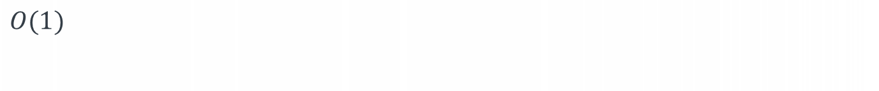
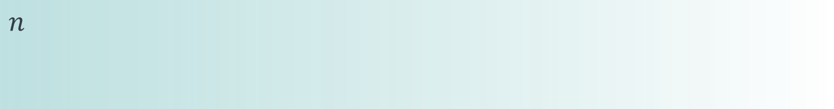

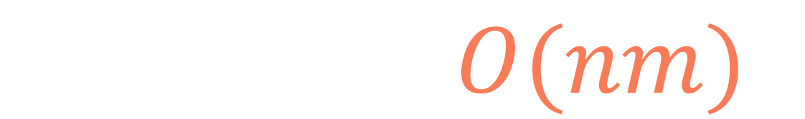
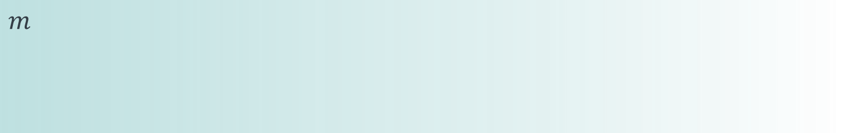

def square(matrix): n, m = len(matrix), len(matrix[0]) dp = [[0] * m for i in range(n)] dp[0][0] = matrix[0][0] for j in range(1, m): dp[0][j] = matrix[0][j] for i in range(1, n): dp[i][0] = matrix[i][0] for i in range(1, n): for j in range(1, m): dp[i][j] = 0 if matrix[i][j] == 0 else 1 + min(dp[i-1][j],
dp[i][j-1],
dp[i-1][j-1]) return max(map(max,dp))**2
$$nm$$
$$n$$
$$O(1)$$
$$n$$
$$O(1)$$
$$m$$
$$n$$
$$O(1)$$
$$T\left(n,m\right)=O(nm)$$

Slide 74
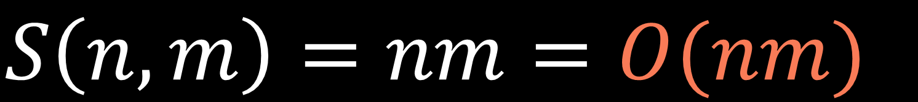
def square(matrix): n, m = len(matrix), len(matrix[0]) dp = [[0] * m for i in range(n)] dp[0][0] = matrix[0][0] for j in range(1, m): dp[0][j] = matrix[0][j] for i in range(1, n): dp[i][0] = matrix[i][0] for i in range(1, n): for j in range(1, m): dp[i][j] = 0 if matrix[i][j] == 0 else 1 + min(dp[i-1][j],
dp[i][j-1],
dp[i-1][j-1]) return max(map(max,dp))**2
$$nm$$
$$S\left(n,m\right)=nm=O(nm)$$

Slide 75
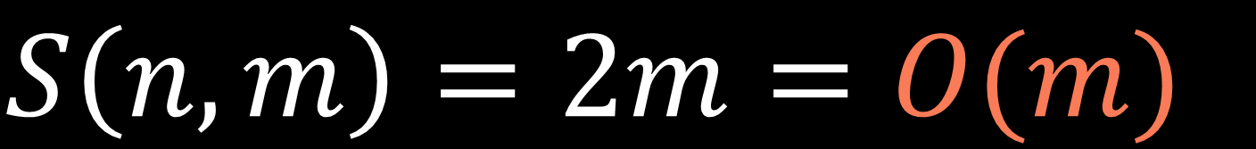


def square(matrix): n, m = len(matrix), len(matrix[0]) prev_dp = [0]*m dp = [0]*m prev_dp[0] = matrix[0][0] max_size = matrix[0][0] for j in range(1, m): prev_dp[j] = matrix[0][j] max_size = max(max_size, prev_dp[j]) for i in range(1, n): dp[0] = matrix[i][0] for j in range(1, m): dp[j] = 0 if matrix[i][j] == 0 else 1 + min(prev_dp[j], dp[j-1], prev_dp[j-1]) max_size = max(max_size, max(dp)) prev_dp = dp dp = [0]*m return max_size**2
$$m$$
$$m$$
$$S\left(n,m\right)=2m=O(m)$$

Slide 76
Square matrix of ones
0
0
1
1
1
0
1
0
1
1
1
1
0
1
1
1
1
0
1
1
1
1
0
1
0
1
0
1
1
1

